Slide 1
Centroids of Areas via Composite Parts
Dr. Jacob Moore
Associate Professor of Mechanical Engineering
Penn State Mont Alto

Slide 2
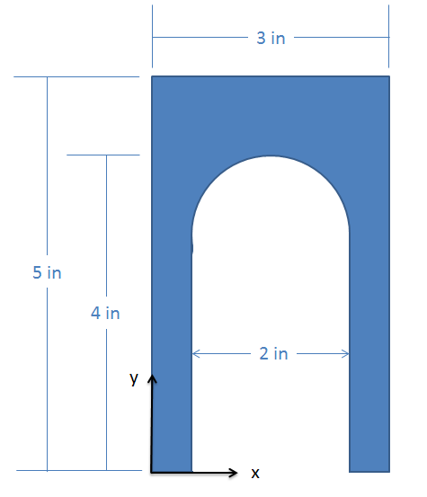
Alternate Methods for Finding the Centroid
The centroid of a shape can always be found via integration, however performing the calculations by hand for more complex shapes can become unmanageably difficult.
One solution is to use the method of composite parts, taking advantage of someone else’s previous work in computing the integrals.
Another solution is to use software tools, such as a CAD software, that can calculate these values for you.

Slide 3
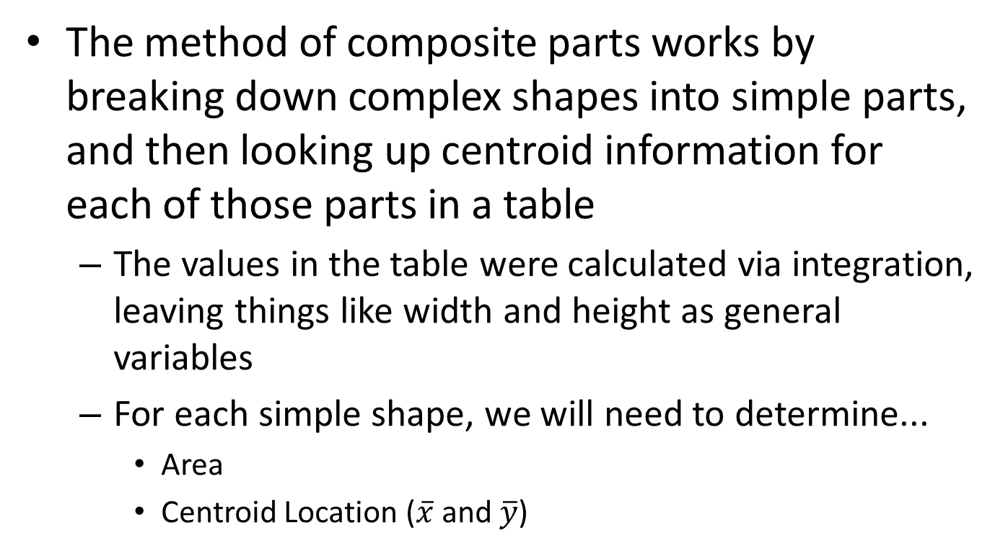
Finding the Centroid via the Method of Composite Parts
The method of composite parts works by breaking down complex shapes into simple parts, and then looking up centroid information for each of those parts in a table
The values in the table were calculated via integration, leaving things like width and height as general variables
For each simple shape, we will need to determine...
Area
Centroid Location ($\overline{x}$ and $\overline{y}$)

Slide 4
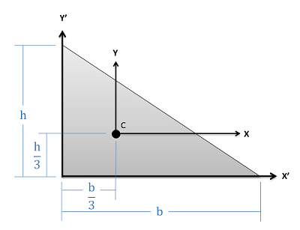
Centroid Tables
The centroid tables provide a generalized centroid location, that will need to be adapted to the exact situation you have.
Let’s use the figure from the table to determine the location of this triangle’s centroid…
Right Triangle from Centroid Table
Triangle in Our Problem
y
4 in
x
6 in

Slide 5
Using the Method of Composite Parts
To use the method of composite parts, we will first need identify an origin point we will use and then break the shape down into simple parts.
Each simple part you create must be in your centroid table.
Regular areas will count as positive areas
Holes or Cutouts will count as negative areas
Y
.
X
2
1
3

Slide 6
Using the Method of Composite Parts
Next, we will record the area, x centroid coordinate, and the y centroid coordinate in a table.
Remember to take the orientation and position of each shape into account when finding the centroid of the shape. The centroid locations should all be relative to the same point.
Shape | Area | $$\overline{X}$$ | $$\overline{Y}$$
1
2
3
1 .
2
Y
X
3

Slide 7
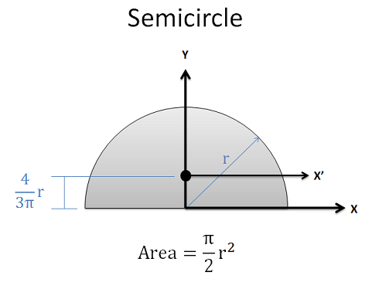
Centroid Locations
Make sure you label all centroid locations with respect to the origin point.
This will often involve reorienting or interpreting the centroid table diagrams
1 .
2
Y
X
3

Slide 8
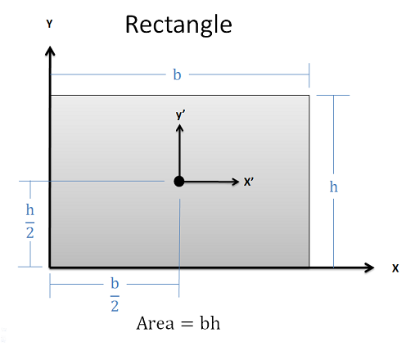
Centroid Locations
Make sure you label all centroid locations with respect to the origin point.
This will often involve reorienting or interpreting the centroid table diagrams
1 .
2
Y
X
3

Slide 9
Using the Method of Composite Parts
Once we have these values, we can use the formulas shown below to calculate the x and y coordinates of the centroid for the whole shape.
$$\overline{x}=\frac{\sum_{1}^{i}{A_{i}\overline{x_{i}}}}{\sum_{1}^{i}{A_{i}}}$$
$$\overline{y}=\frac{\sum_{1}^{i}{A_{i}\overline{y_{i}}}}{\sum_{1}^{i}{A_{i}}}$$
Shape | Area | $$\overline{X}$$ | $$\overline{Y}$$
1
2
3
1 .
2
Y
X
3

Slide 10
Thanks for Watching
See other engineering mechanics videos and access the full tool at…

Slide 11
Worked Example
Use the method of composite parts to determine the centroid of the shape shown below.
y
4 in
3 in
d = 2 in
1.5 in
x
2 in
8 in

Slide 12
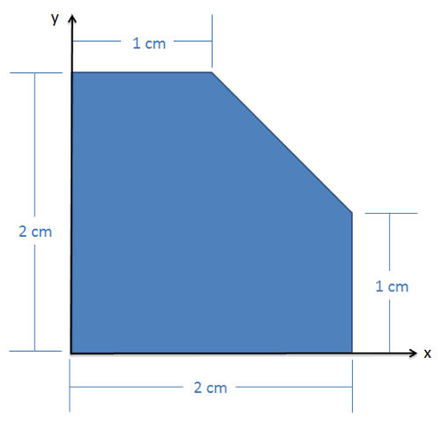
Worked Example
Use the method of composite parts to determine the centroid of the shape shown below.

Slide 13
Worked Example
Use the method of composite parts to determine the centroid of the shape shown below.

